Slide 1
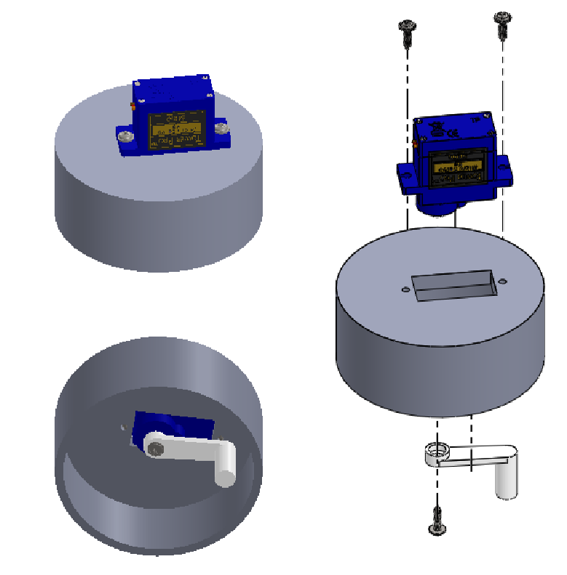
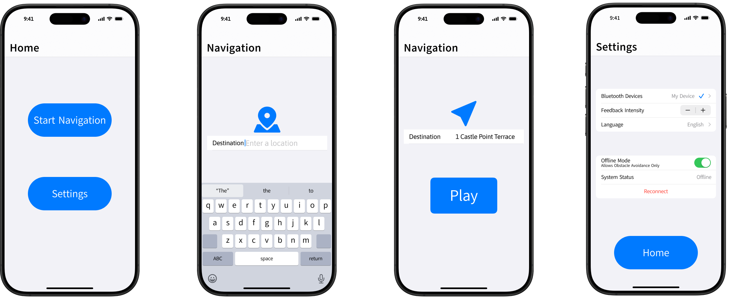
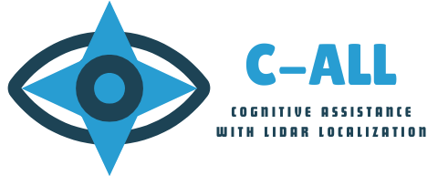
Cognitive Assistance with LiDAR Localization (C-ALL)
Assistive Technology / Smart Mobility Aid
Students: Sohan Chatterjee, Sara Gaber, Neeti Mistry, Ahmad Shah
Advisor: Professor David Darian Muresan, Department of Software Engineering
OBJECTIVE
C-ALL aims to enhance mobility for visually impaired individuals through a smart wearable device. Using LiDAR technology, haptic feedback, and a mobile application, it provides real-time obstacle detection and intuitive navigation assistance. C-ALL also aims to bridge the gap by offering an affordable and user-friendly alternative to traditional mobility aids.
PROBLEM
Visually impaired individual’s face significant challenges navigating public spaces safely.
Limited obstacle detection
High costs and accessibility
Lack of situational awareness
There is a need for a reliable and intuitive solution that improves mobility while keeping safety and independence its main priority.
IMPACT
Enhanced Mobility: Provides real-time obstacle detection, reducing reliance on traditional mobility aids.
Increased Accessibility: Offers an affordable and user-friendly alternative to costly mobility solutions.
Improved Safety: Reduces the risk of collisions with precise, real-time feedback from LiDAR and haptic technology.
Personalized Experience: Customizable settings allow users to tailor navigation assistance to best fit their needs.
By bridging the gap between technology accessibility, C-ALL fosters inclusivity and expands choices for the visually impaired community.
CORE FEATURES
LiDAR Obstacle Detection: Real-time mapping detects obstacles at various distances.
Wearable Smart Glove: Lightweight glove with integrated hardware for seamless obstacle detection.
Haptic Feedback: Tactile vibrations provide intuitive navigation without sensory overload.
Mobile App Integration: Developed with Swift, users can input a destination and customize settings.
Advanced Hardware and Software: Powered by Raspberry Pi, Bluetooth, microcontrollers, and Swift-based software.
Apple Compatibility: Compatible with iPhone 12 Pro+ models, leveraging Apple's LiDAR technology and accessibility features.
SOLUTION
C-ALL revolutionizes mobility for the visually impaired by integrating cutting-edge technology into a wearable hardware device and software application.
LiDAR sensors detect obstacles at varying distances and heights for enhanced environmental awareness.
Haptic feedback provides intuitive navigation through vibrations and movements on the hand to guide the user around obstacles.
The mobile application allows users input a destination and customize feedback settings for a more personalized experience.
Offering a versatile alternative to canes and guide dogs, C-ALL expands mobility aid options for the visually impaired community.

